Slide 1
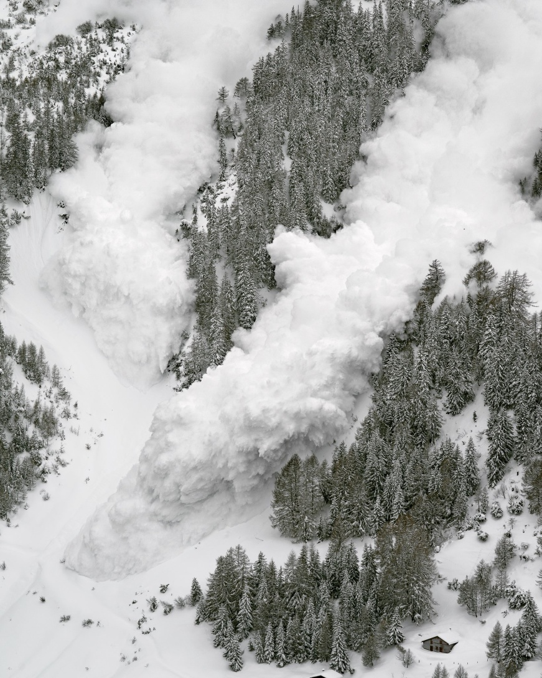
AVALANCHE FORECASTING PREDICTIONS
Project by:
Poornima G B
Sonika Prakash
Spoorthi R S
Ramyashree G T
Anu Bai

Slide 2
INTRODUCTION
Snow avalanches are among the most destructive natural hazards threatening human life, ecosystems, built structures, and landscapes in mountainous regions.
Each year avalanche kills more than 150 people worldwide. The most common cause of death by avalanche is asphyxiation. If the person buried under an avalanche more than 15 minutes then there is no chance of survive. So, the life of the people in that region is difficult to live.
So there is a need of a project that prevents the people from the avalanche by informing them whether there is a chance of the occurrence of avalanche or not.
Our model predicts whether an avalanche occurs or not and its strength based on the data collected from the IOT based sensors.

